Slide 1
ASD Module 2 In-house Project Kick-off
Gijs Dubbelman, November 25, 2016

Slide 2


Content
ACC - ALKA
Project overview
Project phases
Available components
Organizational

Slide 3
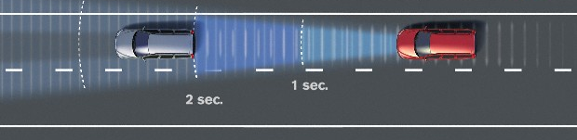
ACC - ALKA
Vision-based Adaptive Cruise Control
Use camera to measure distance to lead vehicle in ego-lane, adjust speed to obtain stable head way distance
Longitudinal control
Vision-based Active Lane Keeping Assist
Use camera to detect and track ego-lane boundaries, adjust vehicle heading to stay in ego-lane
Lateral control

Slide 4

Project Overview
Functional Safety (now - 13-01-2017)
Literature study
Deliverables
Safety requirement document (13-01-2017)
Safety requirement presentation (12-01-2017)
Design (16-01-2017 – 27-01-2017)
Component inventarisation
High-level system design
Deliverables
High-level design document (27-01-2017)
Planning (27-01-2017)
Implementation (30-01-2017 – 28-03-2017)
Component implementation and integration
Evaluation
Deliverables
Update design document and manual (28-01-2017)
Demonstration and presentation (28-01-2017)

Slide 5

Phase 1: Functional Safety
Functional Safety
What are the Euro NCAP requirements for ACC – ALKA
What are the risk levels (ASIL)
How does that translate to functional safety requirements ISO 26262 in terms of
system architecture
Hard- / software
Deliverables
Document (10 pages)
Presentation (40 minutes)

Slide 6
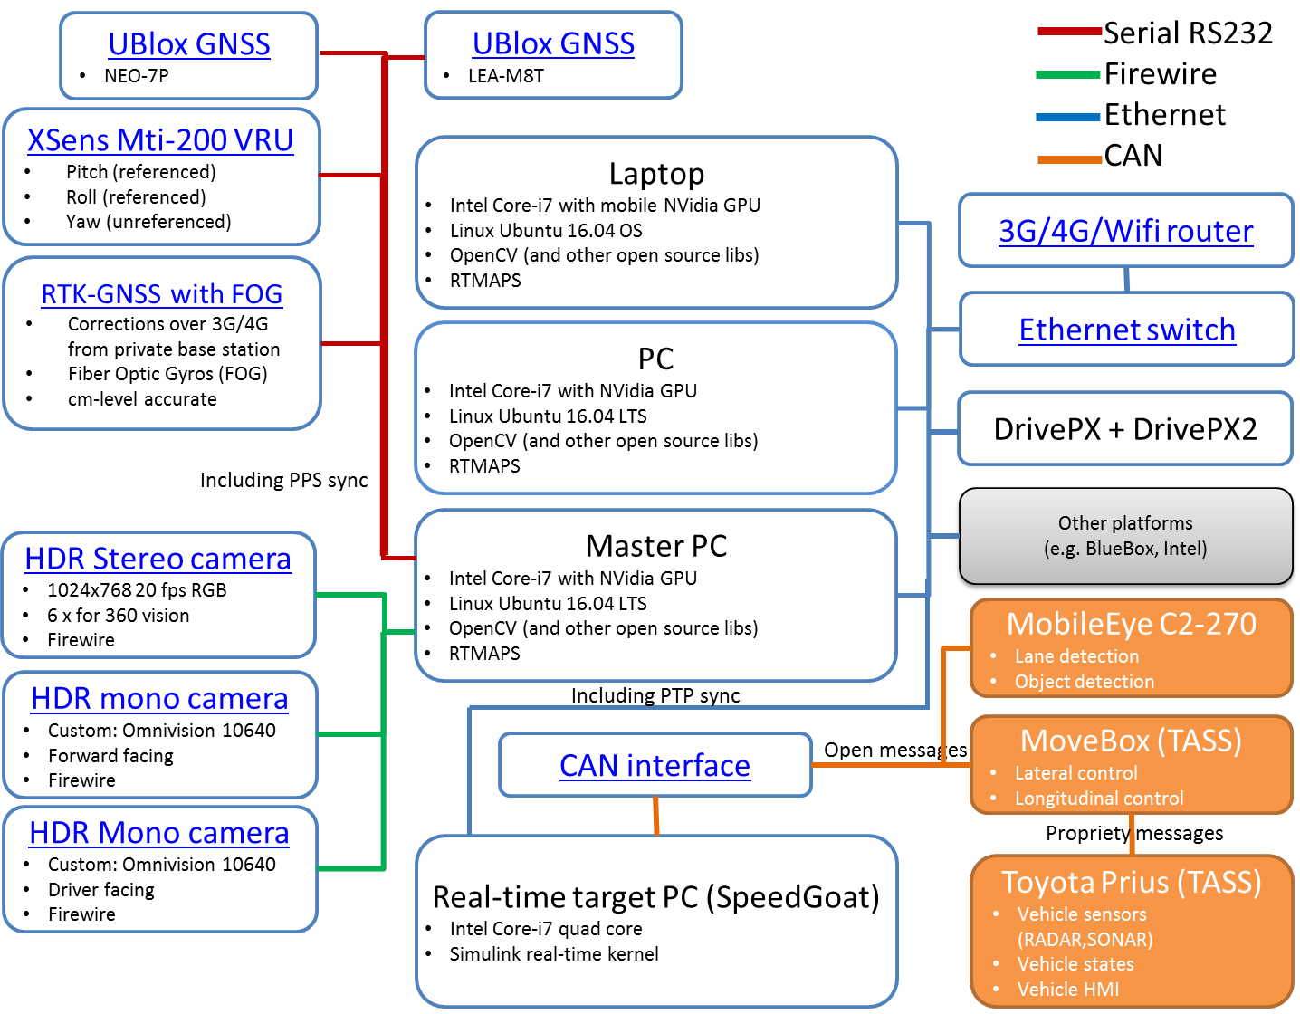
Phase 2: Design
Design
Components
Interfaces
What is available when
What is not
Parallel workshops
Deliverables
High-level design (10 pages)
Planning

Slide 7
Phase 3: Implementation
Implementation
Integration of existing components
Development of new components
Unit-testing of components
System testing
Documenting
Deliverables
Updated design (15 pages)
Demo and presentation (40 minutes)

Slide 8
Components

Slide 9
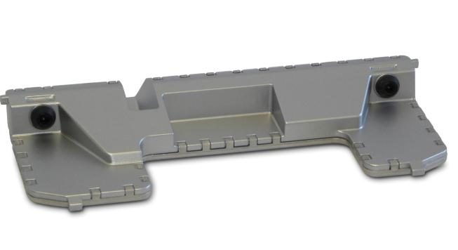
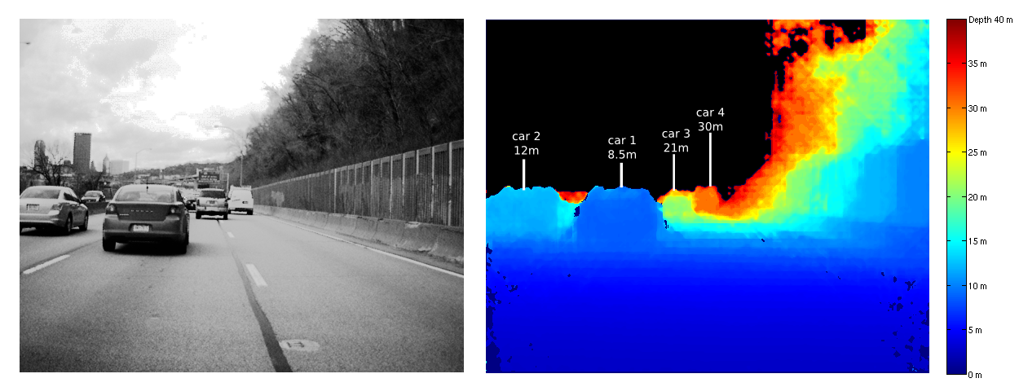
TU/e Lane Stereo Ranging Reference

Slide 10
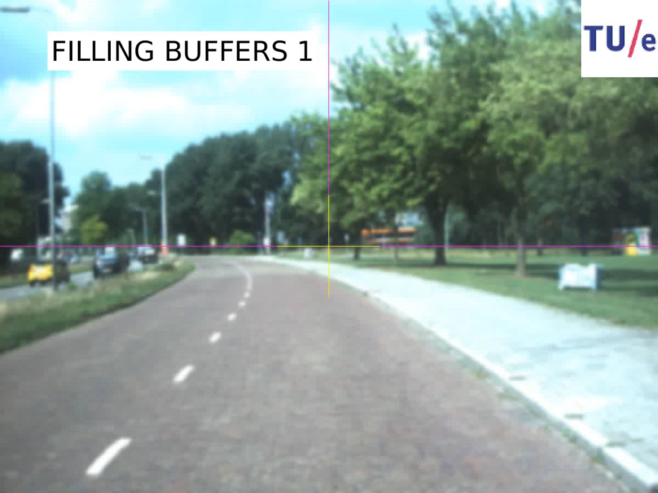
TU/e Lane Detection Reference sign
Notes:
Slide 1: title page
Slide 2: project information
Slide 3: your future perspective

Slide 11
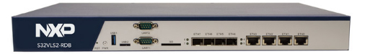
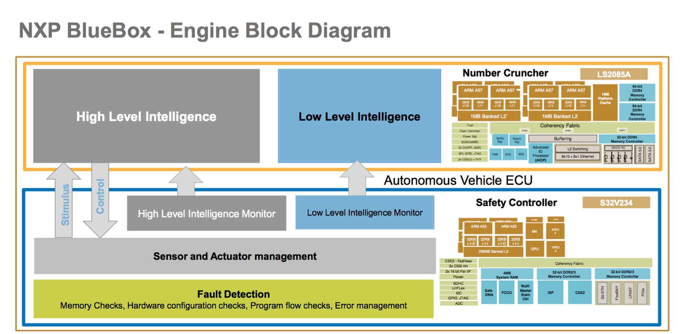
NXP BlueBox
Notes:
Slide 1: title page
Slide 2: project information
Slide 3: your future perspective

Slide 12
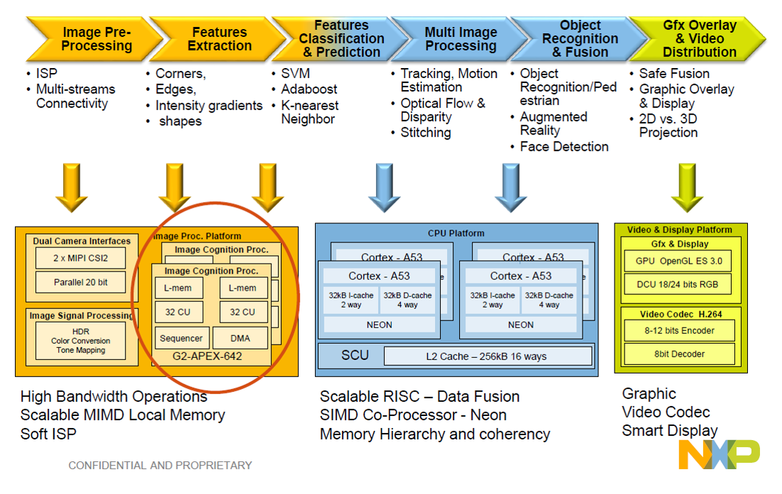
NXP BlueBox
Notes:
Slide 1: title page
Slide 2: project information
Slide 3: your future perspective

Slide 13

Organizational: Guidelines
Less-is-more
Do one use-case good
Focus on one task at a time
Choose a project leader
Project leader is contact point to NXP and TUE
Make sub-teams
Each team member has a clear responsibility
Be self-reliant and pro-active
You’re company, so don’t bother the customer (too much)

Slide 14
Contact Points
NXP “customer”
Rameez Ismail (R.Ismail@tue.nl)
Functional safety
BlueBox
TU/e
Gijs Dubbelman (g.dubbelman@tue.nl)
Sensing algorithms
Jos den Ouden
Prius and its components
Peter Heuberger
Educational affairs
Arash Kabash (arash.khabbazsaberi@tno.nl)
Functional safety

Slide 15

Questions
?

